Slide 1
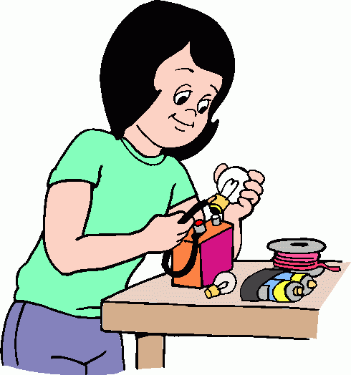
Scientific Notation
Learn to express large and small numbers in scientific notation.

Slide 2
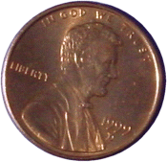
An ordinary penny contains about 20,000,000,000,000,000,000,000 atoms. The average size of an atom is about 0.00000003 centimeters across.
The length of these numbers in standard notation makes them awkward to work with.
Scientific notation is a shorthand way of writing such numbers.

Slide 3
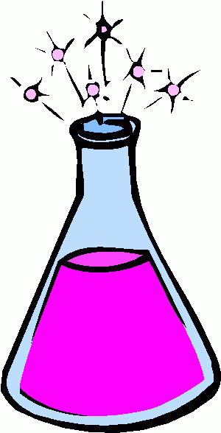
In scientific notation the number of atoms in a penny is 2.0 × 10²², and the size of each atom is 3.0 × 10^{–8} centimeters across.
Helpful Hint
The sign of the exponent tells which direction to move the decimal. A positive exponent means move the decimal to the right, and a negative exponent means move the decimal to the left.

Slide 4
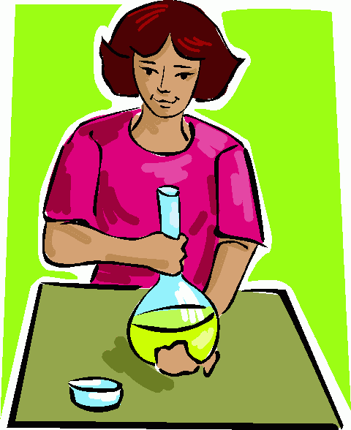
Write the number in standard notation.
A. 1.35 × 10⁵
5
1.35 × 10
10 = 100,000
5
1.35 × 100,000
135,000
Think: Move the decimal right 5 places.

Slide 5
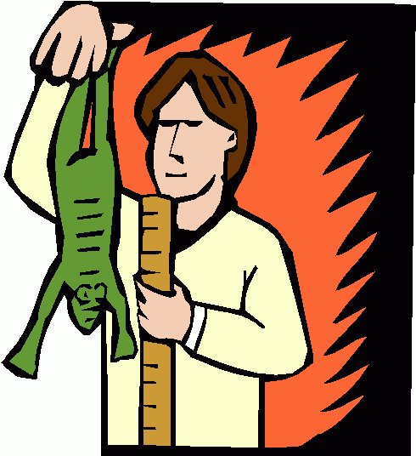
Write the number in standard notation.
B. 2.7 × 10
–3
Think: Move the decimal left 3 places.
0.0027

Slide 6
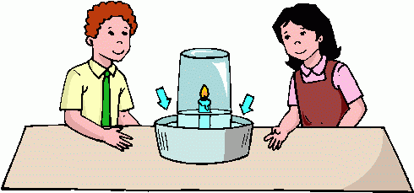
Write the number in standard notation.
C. –2.01 × 10⁴
–20,100
Think: Move the decimal right 4 places.

Slide 7
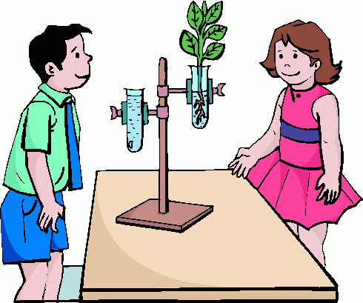
Write the number in standard notation.
D. 2.87 × 10⁹
2,870,000,000
Think: Move the decimal right 9 places.

Slide 8
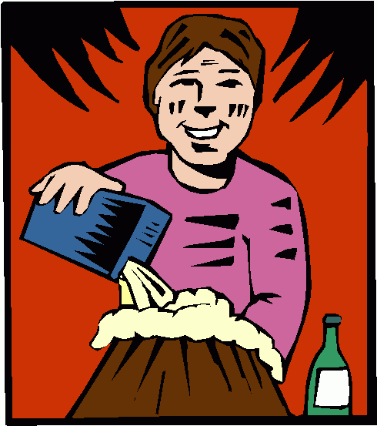
Write the number in standard notation.
E. 1.9 × 10^{–5}
0.000019
Think: Move the decimal left 5 places.

Slide 9
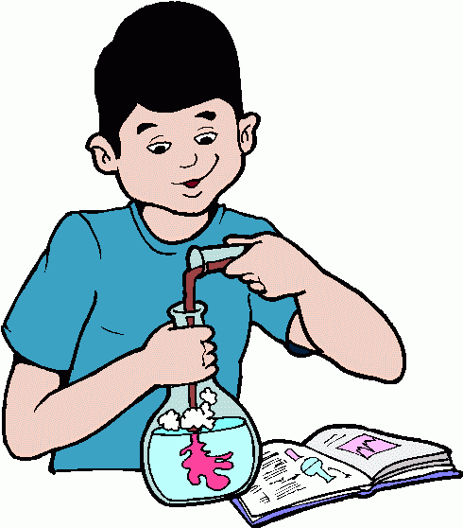
Translating Standard Notation
to Scientific Notation
Write 0.00709 in scientific notation.
0.00709
Move the decimal to get a number between 1 and 10.
7.09
7.09 × 10
Set up scientific notation.
Think: The decimal needs to move left to change 7.09 to 0.00709, so the exponent will be negative.
Think: The decimal needs to move 3 places.
7.09 × 10^{–3} = 0.00709

Slide 10
Write 0.000811 in scientific notation.
0.000811
Move the decimal to get a number between 1 and 10.
8.11
8.11 × 10
Set up scientific notation.
Think: The decimal needs to move left to change 8.11 to 0.000811, so the exponent will be negative.
Think: The decimal needs to move 4 places.
So 0.000811 written in scientific notation is 8.11 × 10^{–4}.
Check 8.11 × 10 = 0.000811
–4

Slide 11
Lesson Quiz
Write in standard notation.
1. 1.72 × 10⁴
17,200
2. 6.9 × 10^{–3}
0.0069
Write in scientific notation.
5.3 × 10^{–3}
3. 0.0053
4. 57,000,000
5.7 × 10⁷
5. A human body contains about 5.6 x 10⁶ micro-liters of blood. Write this number in standard notation.
5,600,000

